Slide 1

Search Graphs
Benefits from Pre-Computation

Slide 2
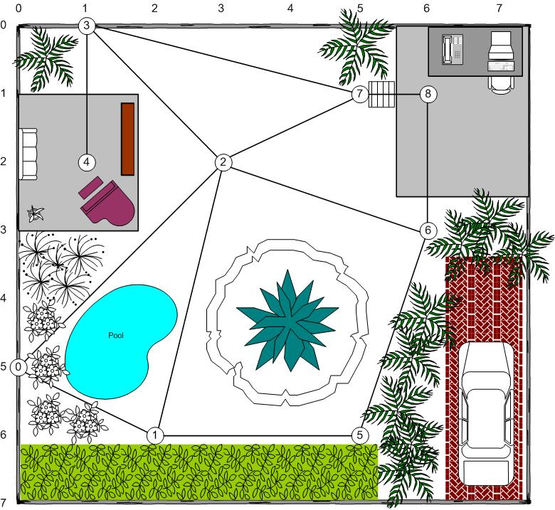
Graph Search Variants
For tile-based path planners, the terrain and the search topology (the search space) are the same. However, we can also use a separate graph for the search space based on geometric terrain (2D or 3D).
Waypoint Graphs
Nodes are points in space
Edges are line segments with length
Returns line-based path, point-to-point
Waypoint graphs can suffer from suboptimal and/or unnatural looking paths due to poor placement, etc. Adding nodes near corners can help, though.
Navigation Meshes
Nodes are polygons
Edges are portals between polygons
Returns a polygon channel
Navigation meshes usually require additional techniques to develop a path from the channel (such as funneling, string pulling, midpoints, or visible points tightening).

Slide 3
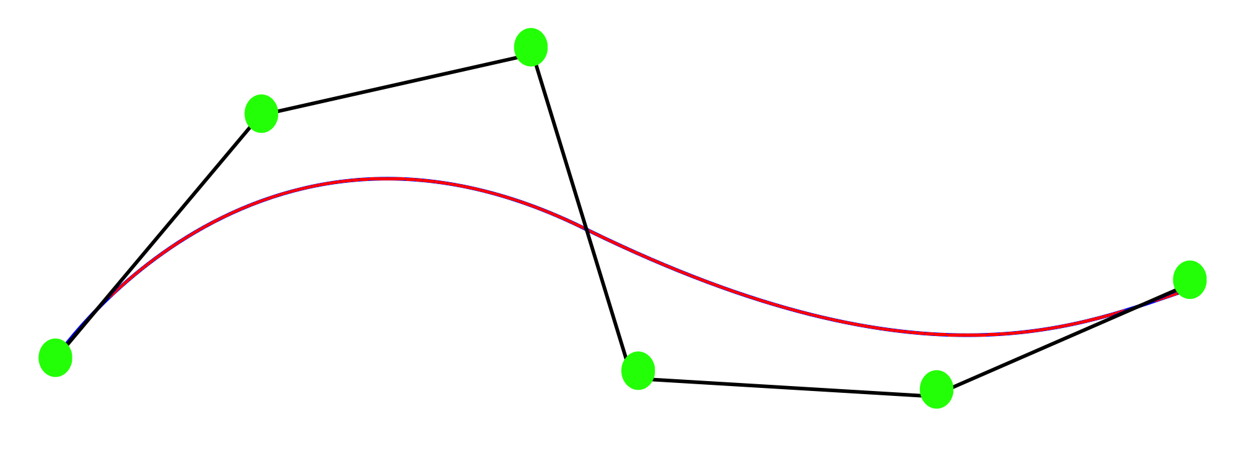
Navigation Mesh Path Smoothing
Splines: Squirrel Interpolation and Splines
Funneling: Simple Stupid Funnel Algorithm
Midpoints: AI Systems of Left For Dead (p. 12)
Visible Points Tightening: AI Systems of Left For Dead (p. 13-26)

Slide 4

Automatic Graph Generation
Graphs can be automatically generated and updated.
Nav-meshes can be automatically generated/deformed, but it’s hard – there’s no general purpose solution published.
Unfortunately, most deforming solutions are trade secrets.^{[1][2]}
Waypoint graphs are not usually automatically generated; when they are, human review is often required.

Slide 5
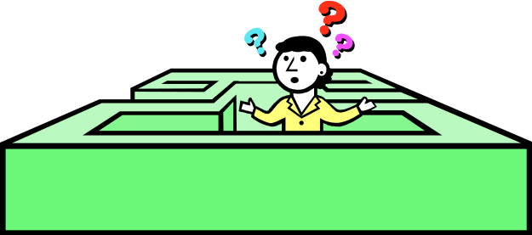
Getting Unstuck
In dynamic situations, a path may become unavailable after planning, requiring on-the-fly solutions:
Local avoidance
  waiting, retreating, or retrying
  Reciprocal velocity obstacles (RVO/ORCA)
  Steering behaviors (next lecture!)
  Push-off (careful; can look unnatural)
Behavior change
  Replanning (takes some time)
  Giving up (requires indication to player)

Slide 6
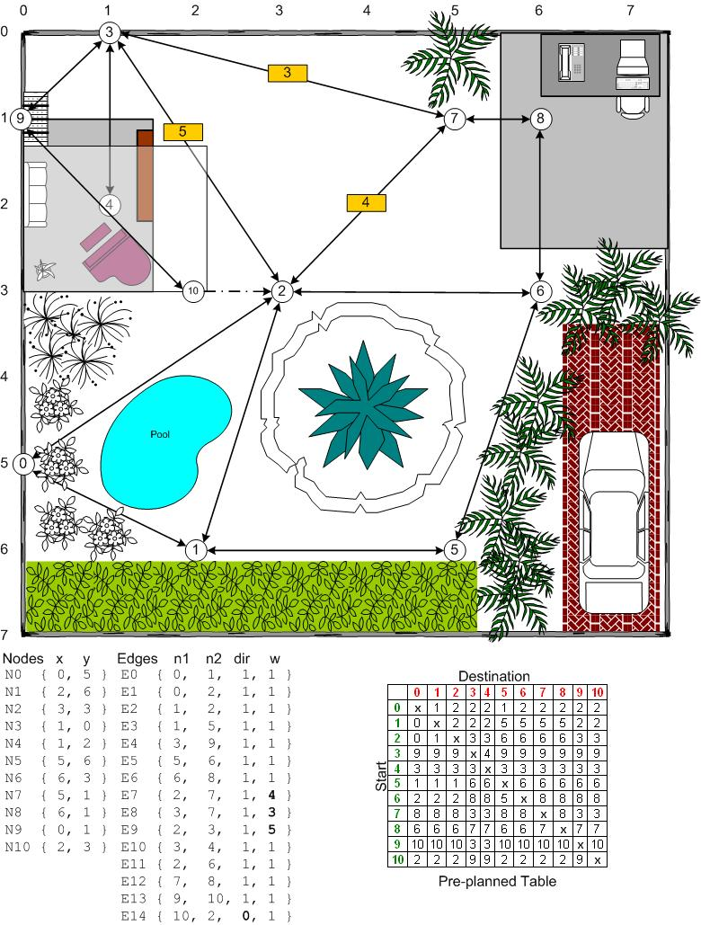
Graph Optimizations:
Preplanning

Slide 7

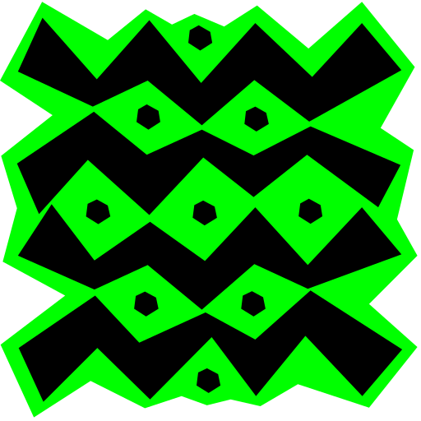
Graph Optimizations:
Preplanning
Preplanning Benefits:
Very, Very Fast
CPU and memory friendly (at search time)
Preplanning Drawbacks:
Not dynamic
More nodes = more memory (exponential)
Memory Use Mitigation Techniques:
Smaller data types
Use relative, not absolute nodes (node 1, 2, …)

